Slide 1
BUSINESS ETHICS & CORPORATE SOCIAL RESPONSIBLITY
Made By: Dhrunaivi Gandhi
Ennrollment No:160410116033
Guided By:Disha Patel

Slide 2
INTRODUCTION
Ethics: is a set of rules that defines right and wrong conduct .
Business Ethics: can be defined as written and unwritten code of principles and values that govern decision and action within the company.
It is system of moral principle and value applied to business activities.
Business Ethics is an art or science on maintain harmonious relationship with society.
04/16/15

Slide 3
Seven principles of Admirable Business Ethics
Be trustful
Keep an open mind
Meet obligation
Have clear documents
Become community involved
Maintain accounting control
Be respectful
04/16/15

Slide 4
Importance of Business Ethics
High ethical performance also protect the individual who work in business.
Encourage business firms and their employees to behave ethically is to prevent harm to society.
It has far reaching consequence for business
Ethical contribute to profit
04/16/15

Slide 5

Corporate Social Responsibility
CSR means social responsibility of corporate sector, which also means response of the corporate sector towards society.
A company concern and commitment towards society sustainability and development.
CSR is the ethical behavior of company towards society.
An idea where by companies integrate economic, social and environmental concerns in their business operation.
04/16/15

Slide 6
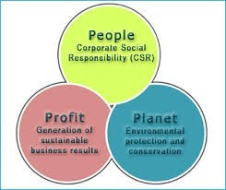
Aims of CSR
Environmental Aims
Social and community activities
Sustainable development
Ethical issues
Business relationship
04/16/15

Slide 7
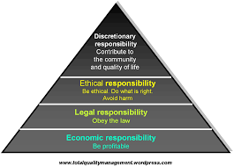
Pyramid of corporate social responsibility
04/16/15

Slide 8
Objectives of CSR
To maximize the company outran impact of the society and stakeholder.
To give back the community in the past possible way in return to the resources.
To create awareness about the company and build its public profile.
To Support various campaign on social and development issue that need support to have a greater impact.
04/16/15

Slide 9
Driving forces behind CSR
Globalization
Power and influence of business corporation
Growth access to education and information
Growing awareness of environmental issue.
Spread of corporate scandal and public distrust.
04/16/15

Slide 10
Stages in CSR
Managers of the company get to know the most common social problem and then express willingness to take a particular project which will solve some social problem.
Intensive study of the problem by hiring experts and getting suggestion to make it operates.
Manager take up the project actively and work hard.
Evaluating of the project by addressing the issue.
04/16/15

Slide 11

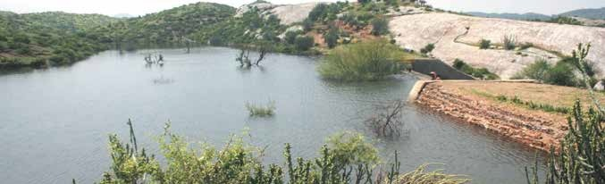
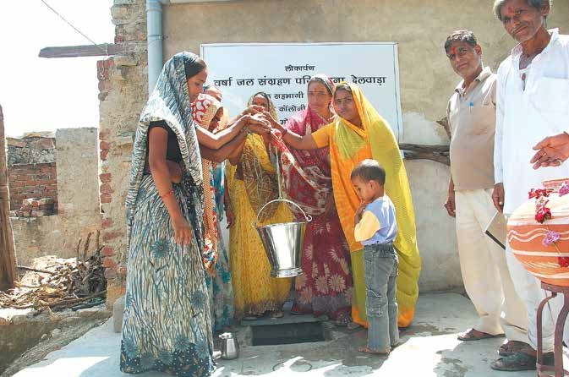
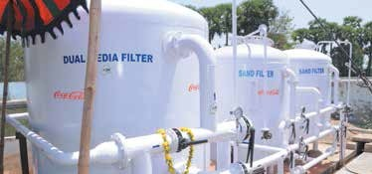
COCA-COLA CRS MODEL
WATER:
Conserve Water
Watershed protection, rainwater harvesting projects
110 recharge shafts that collected rainwater. Reverse filter system.
The company initiated drinking water projects in Maharashtra and Gujarat to provide potable water to the local communities
04/16/15

Slide 12

Cont..
ENERGY:
Reducing energy consumption and emission of GHGs by such as refrigeration
freshment cooler that used technologies devoid of hydrofluorocarbons
•
•
GHG emission reduced by three-fourths
increase the energy efficiency of its equipment by 40 to 50%
04/16/15

Slide 13
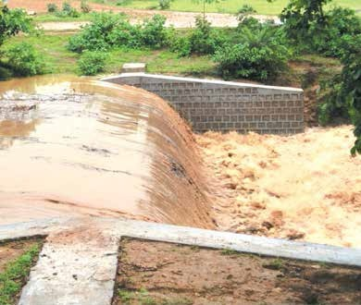
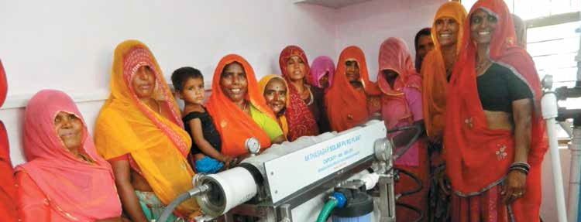
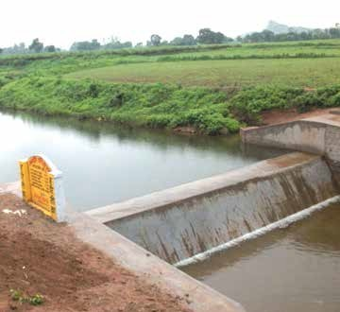
Cont……
PACKAGING AND RECYCLING:
•
•
Packaging framework that aimed at recycling
A PET recycling project in Mumbai in partnership with Brihan
Mumbai Municipal Corporation
•
Collected the company’s packaging material consisting of glass
bottles, cans, etc. after they were disposed .
04/16/15

Slide 14
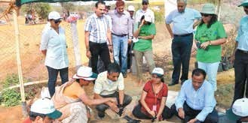
Cont….
HEALTH:
Provided health checkups, medicine, and education to rural communities on health-related topics
•
•
Also funded polio eradication camps
Company conducted blood donation camps and supported a 24-hour
emergency service for children
•
In a few districts of Andhra Pradesh, conducted camps for Hepatitis B
vaccinations, eye checkups, and malaria eradication
04/16/
15

Slide 15


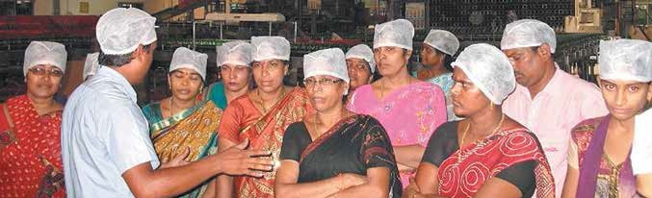
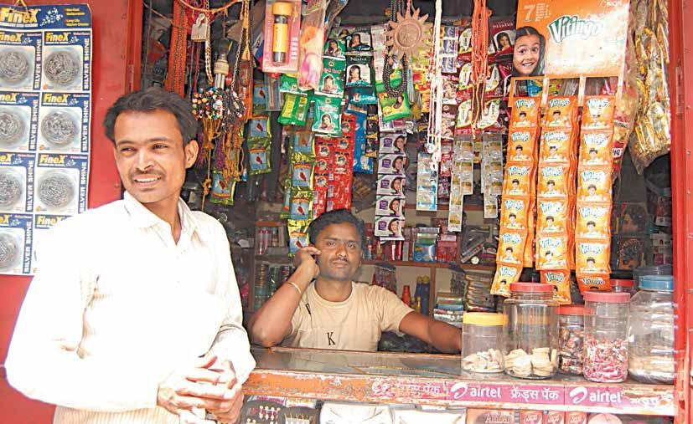
Cont…
ECONOMIC RESPONSIBILITIES:
Played an active role in providing employment and giving the community opportunities to expand and grow
For every job in the Coca-Cola system, 10 more jobs were created indirectly
In 2007, launched an initiative called Parivartan (Change) for training small retailers in India.
04/16/15

Slide 16

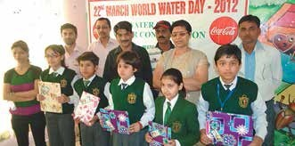

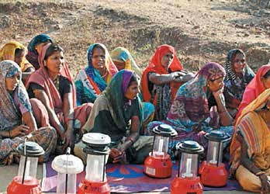
Cont…
COMMUNITIES:
A commitment to the community was part of Coca-Cola India’s CSR
In 2003,launched Jagriti Learning Centers to provide education to more than 1,800 children residing near its bottling facilities in Pune
•
•
The initiative aimed to curb waterborne diseases
It set up around 2,000 schools for children
04/16/15

Slide 17
Cont…
OBSTACLES
The groundwater levels had dropped in the firsts seven years of the company’s operations, from 1999 to 2006
Even in 2008, the company continued to face mass demonstrations from local communities who demanded that the company shut down its bottling operations
•
There were also allegations that the company had seized land from
farmers and that it had discharged hazardous material
•
A few critics came down heavily on Coca-Cola’s much acclaimed
TCCC standards for waste management
04/16/15

Slide 18

Cont…
RESPONSE
Coca-Cola opened an exclusive website, www.cokefacts.org, which addressed the allegations related to India and other countries
The National Geophysical ResearchInstitute (NGRI), which had concluded that there was no field evidence of overexploitation of the groundwater reserves in the area surrounding the plant
•
Coca-Cola stated that the technology used for waste water treatment
at the plant was among the most advanced in the world.
•
Coca-Cola India had carried out its CSR activities across 45 bottling
plants at an annual spend of Rs. 70 to 80 million
04/16/15

Slide 19

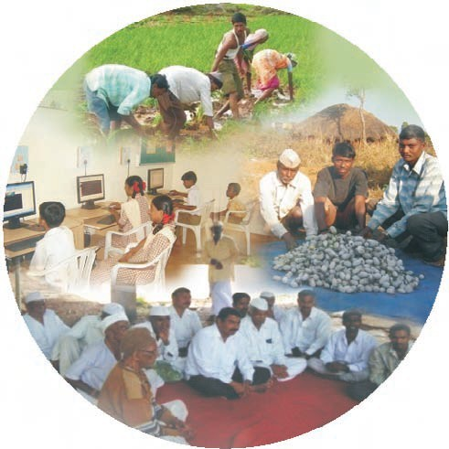

Tata Group & CSR
CSR Activities of Tata Companies & Societies Self-Help Groups (SHG’s)
Over 500 self-help groups are currently operating under various poverty alleviation programs; out of which over 200 are engaged in activities of income generation thorough micro enterprises. Women empowerment programs through Self-Help Groups have been extended to 700 villages.
04/16/15

Slide 20
Cont….
b) Supports Social Welfare Organizations
Tata Steel supports various social welfare organizations. They include;
Tata Steel Rural Development Society
Tribal Cultural Society
Tata Steel Foundation for Family Initiatives
National Association for the Blind
Shishu Niketan School of Hope
Centre for Hearing Impaired Children
Indian Red Cross Society, East Singhbhum
04/16/15

Slide 21

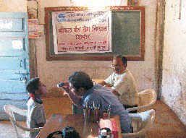
Cont……
•
Healthcare Projects In its 100th year, the Tata Steel Centenary
Project has just been announced. The healthcare projects of Tata Steel include facilitation of child education, immunization and childcare, plantation activities, creation of awareness of AIDS and other healthcare projects.
04/16/15

Slide 22

Cont…..
•
Economic Empowerment A program aiming at economic
empowerment through improvised agriculture has been taken up in three backward tribal blocks in Jharkhand, Orissa and Chhattisgarh. An expenditure of Rs 100 crore has been estimated for the purpose and this program is expected to benefit 40,000 tribal living in over 400 villages in these three States.
04/16/15

Slide 23


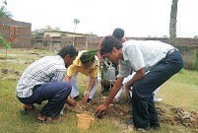
Cont…
Restoring Ecological Balance
Tata Motors has planted 80,000 trees in the works and the township and more than 2.4 million trees have been planted in Jamshedpur region. Over half a million trees have been planted in the Poona region. The company has directed all its suppliers to package their products in alternate material instead of wood. In Pune, the treated water is conserved in lakes attracting various species of birds from around the world.
04/16/15

Slide 24
Conclusion
•
Many business organizations have been engaged in different
corporate social responsibility initiatives which enhance the livening standard of people.
04/16/15

Slide 25
THANK YOU

